Slide 1
MappView for EFI
Jorge Murria 27/Oct/2020

Slide 2
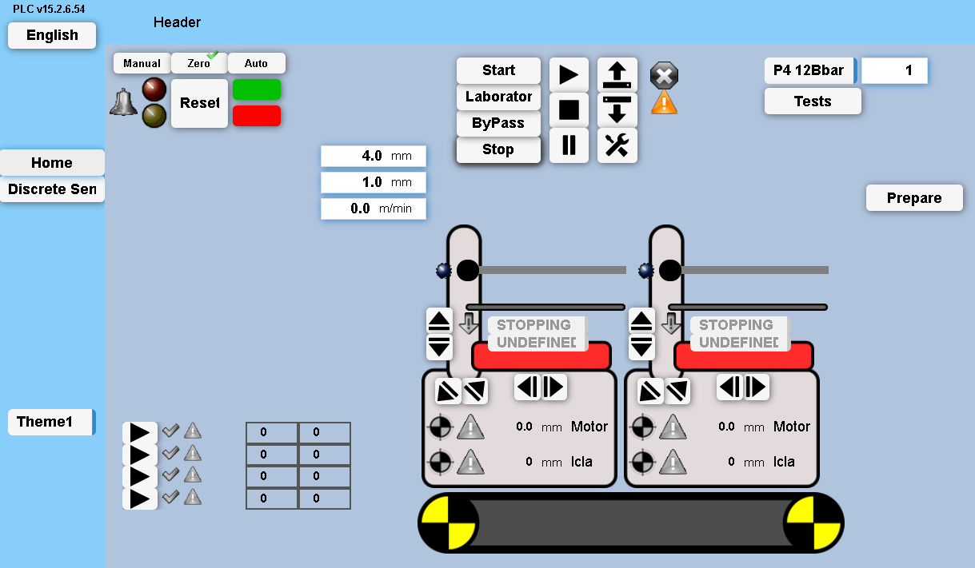
Introduction
Visualization technology in B&R PLC
Multi-Client/Multi-user
Based in OPC UA
Fast, security, events
Web based technology
Based in Identifyers
Integrated HELP in AS gives a lot of information
http://localhost:81/index.html
2

Slide 3
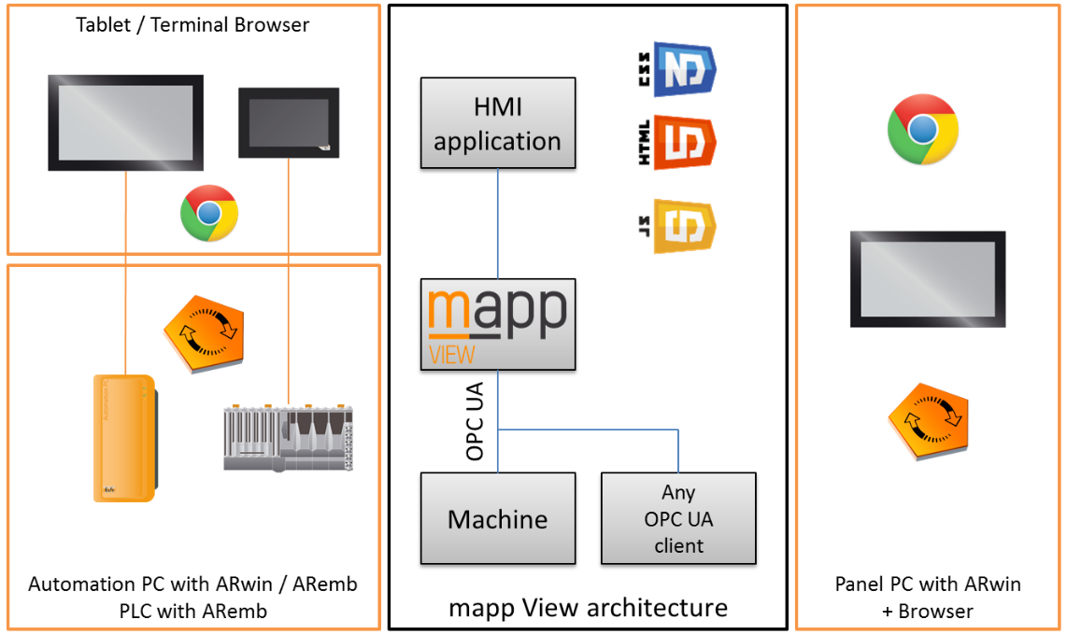
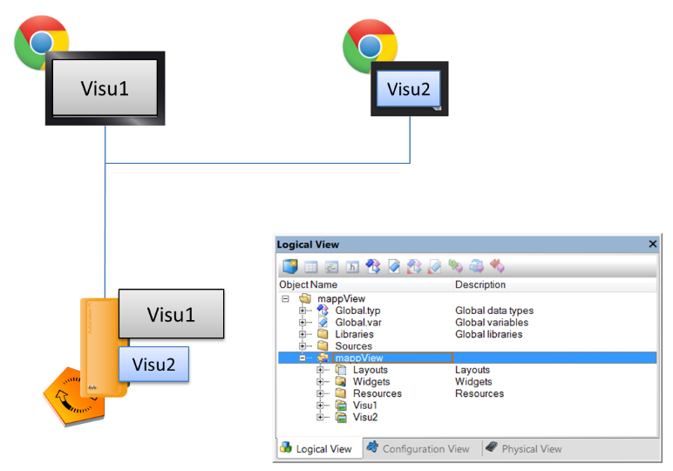
Topologies
3

Slide 4
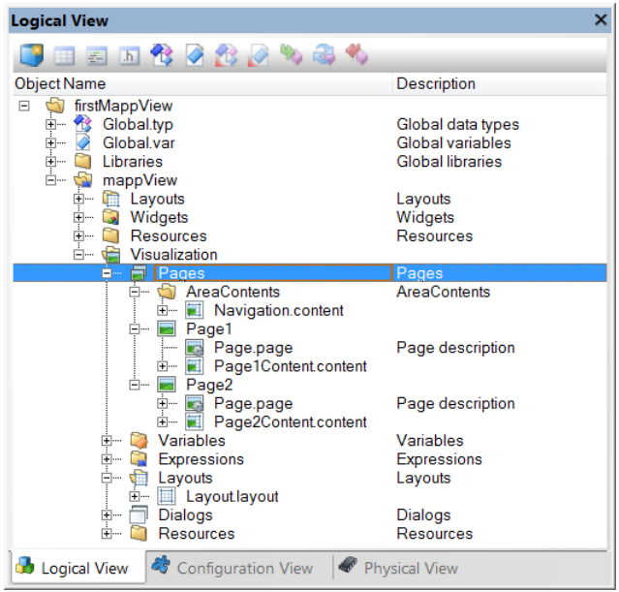
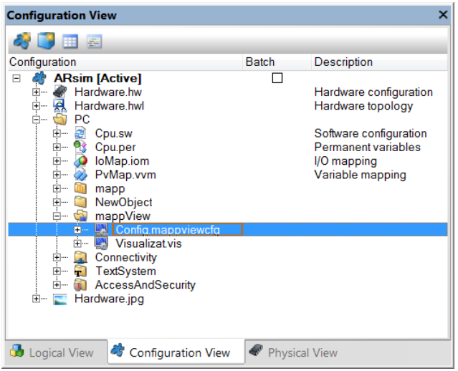
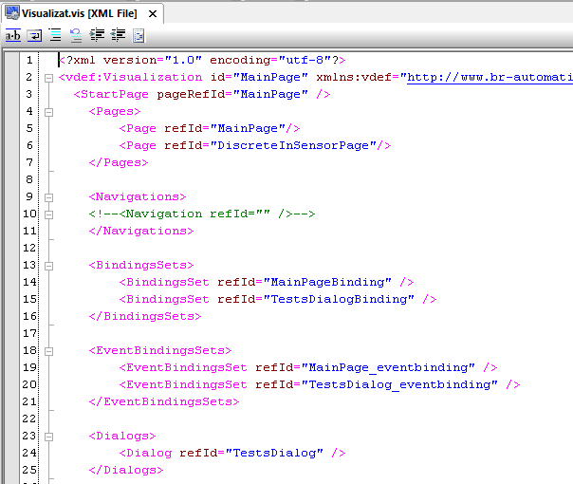
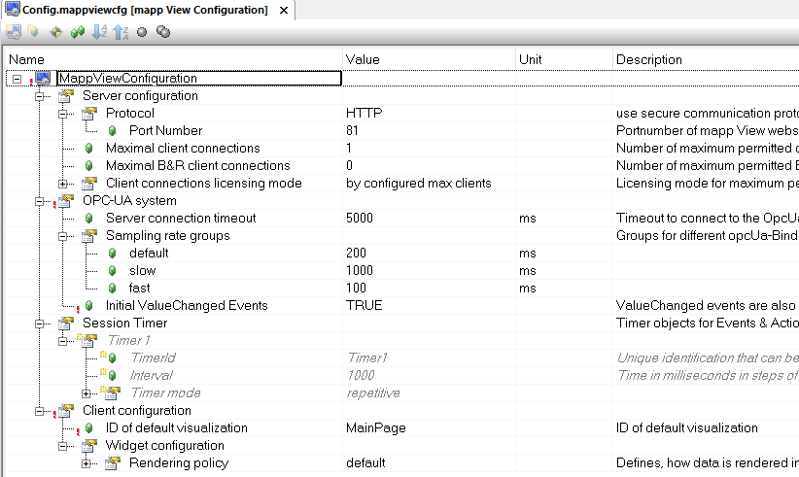
Structure of application
MappView folder in Logical
Full application definition
App definition in Configuration
Running events and bindings
XML files
4

Slide 5
Elements of HMI (1)
NumericInput
PushButton
ImageList
Dropdown
Page
Contents
Button
Widget
Compound
Widget
NumericOutput
Area
Image
5

Slide 6
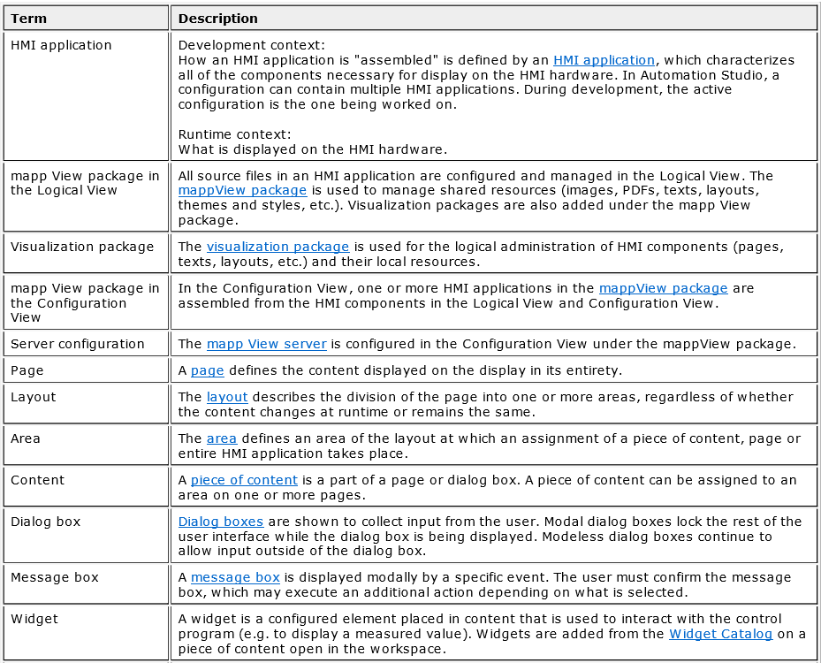
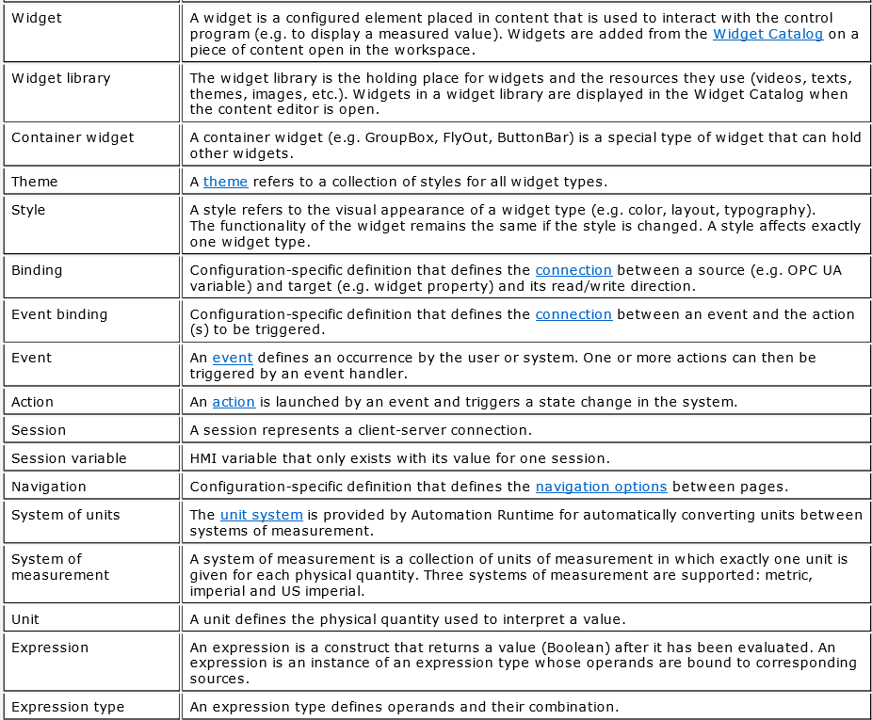
Elements of HMI (2)
6

Slide 7
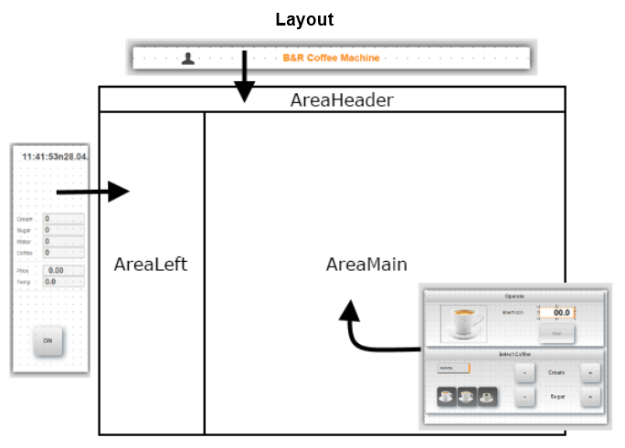
Elements of HMI (3)
Page → Layout
A Layout contain Areas
Sizes and positions
Area contains a Content
Widgets
Labels, Images, etc
7

Slide 8
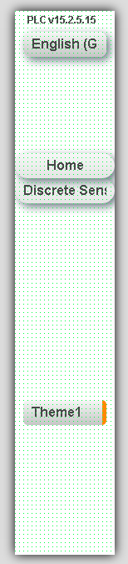
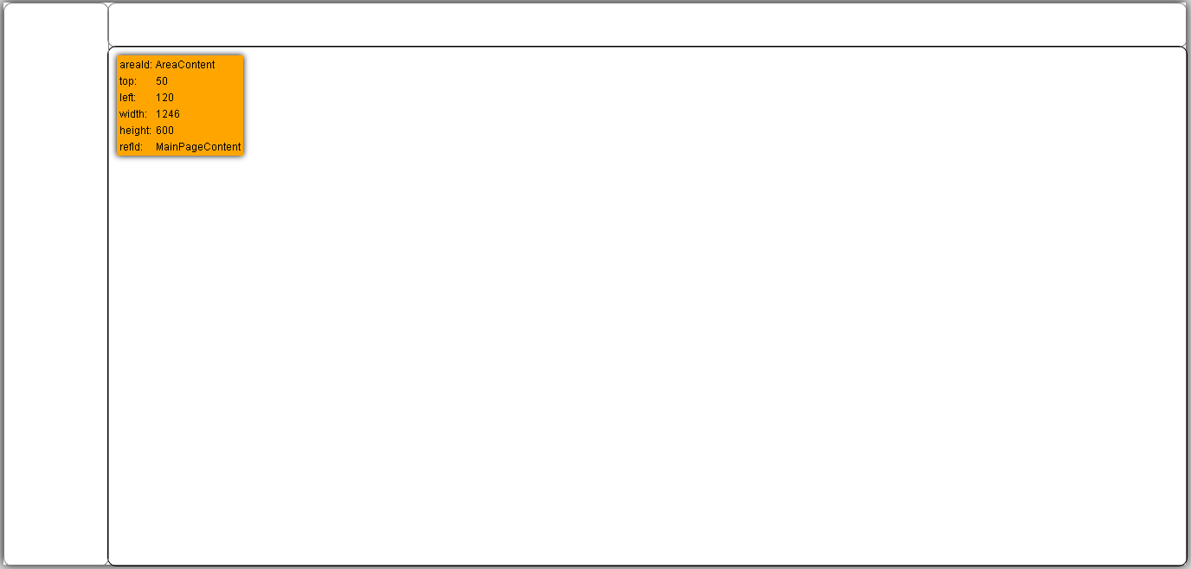
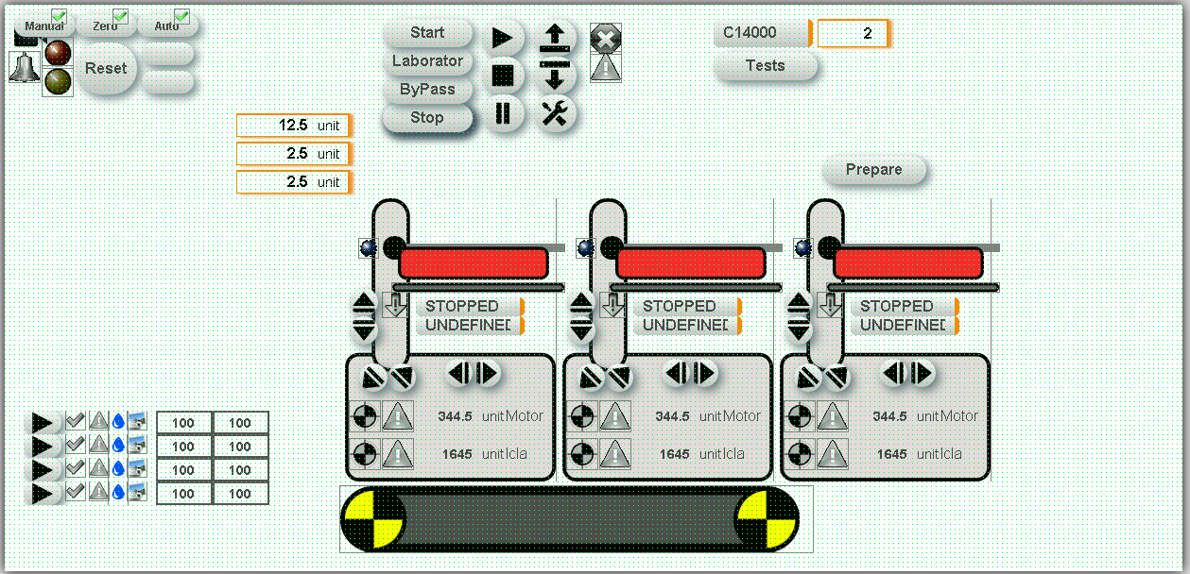
Elements of HMI (3.1)
8

Slide 9
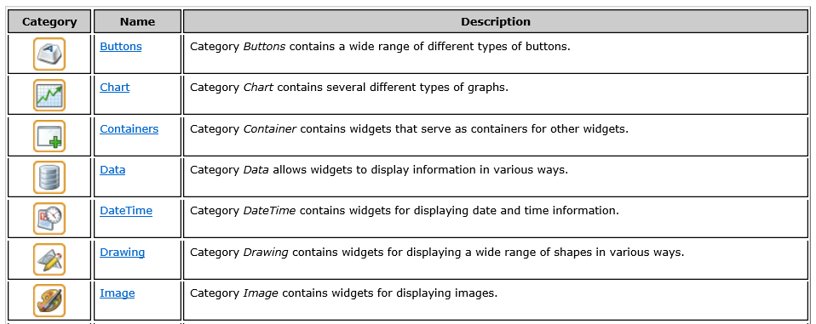
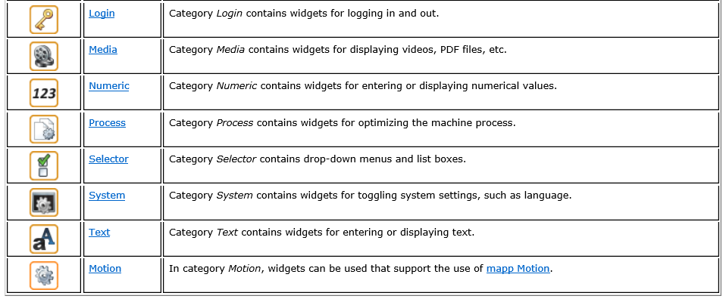
Widgets (1)
9

Slide 10
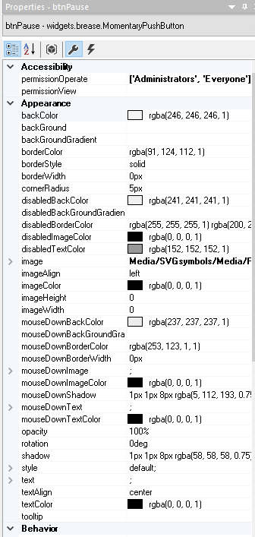
Widgets (2)
All the configuration in Properties
Possible select more than 1 object
Texts definition
Direct
From Texts file
Image/media definition
From resources
10

Slide 11
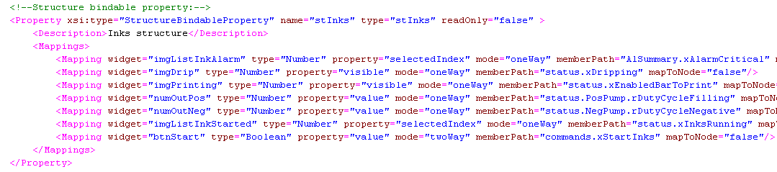
Compound Widgets (1)
Already created an EFIWidgetLib
The CompoundWidget do not have graphical
Defined a DevelopContent to create the Content
Copy the widgets from DevelopContent & Define the mapping
11

Slide 12
Bindings
Relation between widgets and data
Specific for each configuration
Enabled in the configuration of the application
Read, write, read/write
XML file, plain text
12

Slide 13
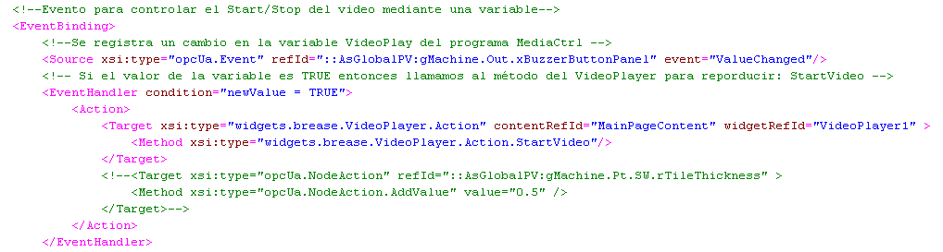
EventBindings
Actions to do after an event
Specific for each configuration
Enabled in the configuration of the application
Source –> Handler –> Action –> Target
13

Slide 14
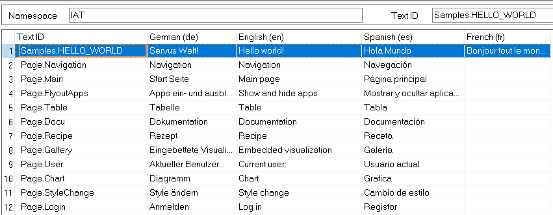
Texts
Defined in Resources/Texts/PageTexts.txm
Languages defined in the project
Namespace IAT (cannot be changed)
Assignation: $IAT/TextID; Sample:$IAT/Mach.Reset;
14

Slide 15
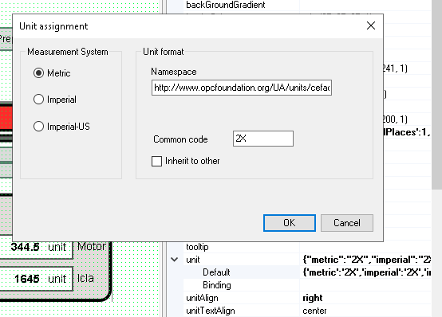
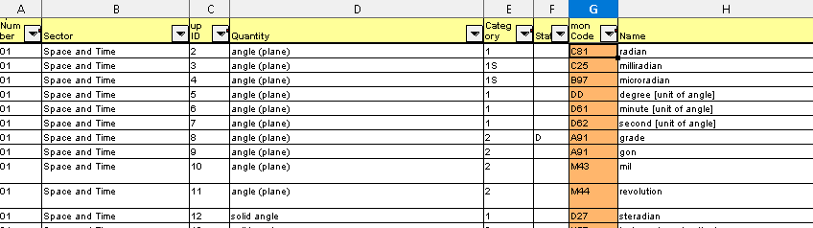
Units
Search the desired unit in Code for Units.xls
Define the Unit in the widget
Input the value in the orange column
15

Slide 16
OPC UA (1)
The server is define per Configuration
Config→ Connectivity→ OpcUA→ OpcUaMap.uad
Global variables & Program Variables
Users in AccessAndSecurity
Users and roles
Permissions defined in server variables
16

Slide 17
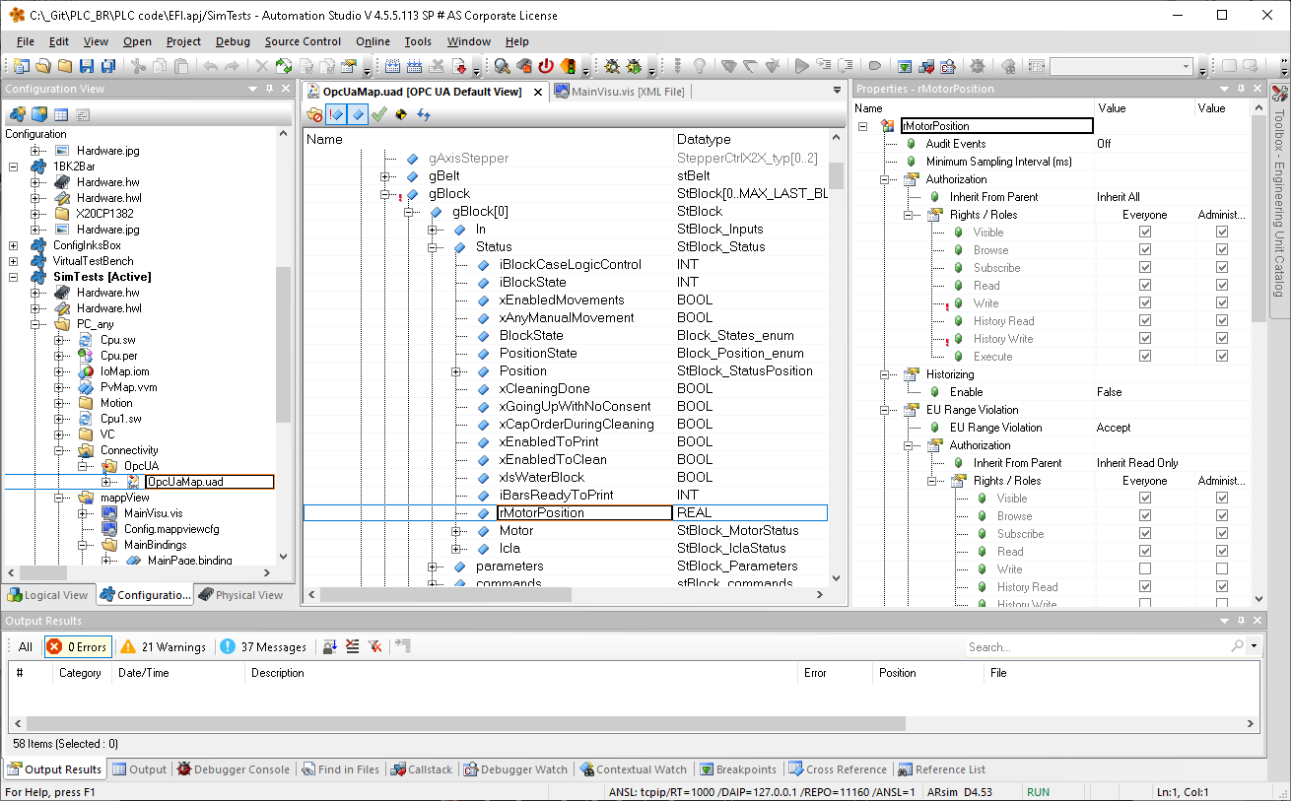
OPC UA (2)
17

Slide 18
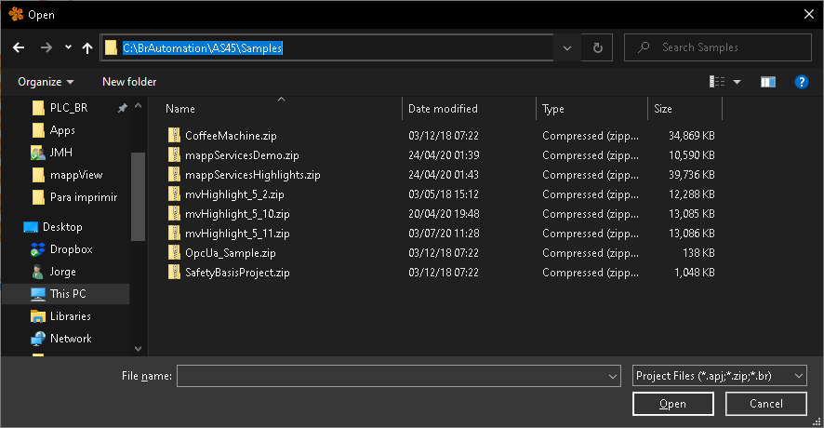
Sample in Automation Studio
Sample when installing version
Unzip file in destination
Open project
Review sample
18

Slide 19
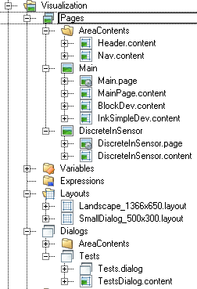
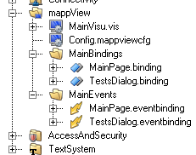
Programming rules.1
All identifyers MUST finish with the type
The identifier -->FileName_ElementType
_Page _Layout
_Content _Dialog
_Binding
_EventBinding
19

Slide 20
Programming rules.2
All binding files MUST be reformatted before committing to repository
Using Notepad++
XML Tools plugin
Pretty Print [Ctrl+Alt+Shift+B]
20

Slide 21
Programming rules.3
Diagnosis page to visualize directly PLC cards
Using Compound widgets
Add Compound widgets if necessary
21

Slide 22
Programming rules.4
Enable OpcUa structures in Automatic Mode
Work with permissions
Reduce maintenance of code in server
22

Slide 23
Programming rules.5
Texts and alarms stored in csv file
Define code, text and variable to raise alarm
Automatically created texts indexes
Automatically created alarms code
Indexed can be used from widgets
23

